Slide 1

Module 3: Cyber Kill Chain / MITRE ATTACK
(Attacker Lifecycle & Defense Mapping)

Slide 2
Cyber Kill Chain
The Cyber Kill Chain is a model used in cybersecurity to describe the stages of a cyberattack from beginning to end.
It helps security teams understand how attackers operate and where they can stop the attack.
The concept was developed by Lockheed Martin to analyze and prevent cyber intrusions.
Just like in military operations where a “kill chain” describes steps to destroy a target, the cyber kill chain describes steps attackers follow to compromise a system.
Cyber Kill Chain = A step-by-step model showing how a cyber attack happens.

Slide 3
Cyber Kill Chain Vs. Attack Lifecyle
So, the ethical hacking phases describe what the attacker does, while the kill chain helps defenders detect and stop attacks.
The Cyber Kill Chain model was introduced by Lockheed Martin.
Model | Purpose
5 Phases of Ethical Hacking | Used by penetration testers to simulate attacks
Cyber Kill Chain | Used by security defenders to analyze real cyber attacks
Key Conceptual Difference
Ethical Hacking Model Focuses on penetration testing methodology. Used by: Penetration testers Ethical hackers Security auditors | Cyber Kill Chain Model Focuses on defending organizations from advanced threats. Used by: SOC analysts Threat hunters Incident responders

Slide 4
7-Stages of Cyber Kill Chain
A 7-stage model describing how real-world cyber attacks unfold.
Stages are:
Reconnaissance– Attacker gathers information (IP, domains, employees)
2. Weaponization– Preparing malicious payload
3. Delivery– Payload delivery (email, USB, website)
4. Exploitation– Triggering vulnerability
5. Installation– Installing malicious code
6. Command & Control (C2)– Remote communication
7. Actions on Objectives– Data theft, disruption
No live malware or exploit development here.

Slide 5
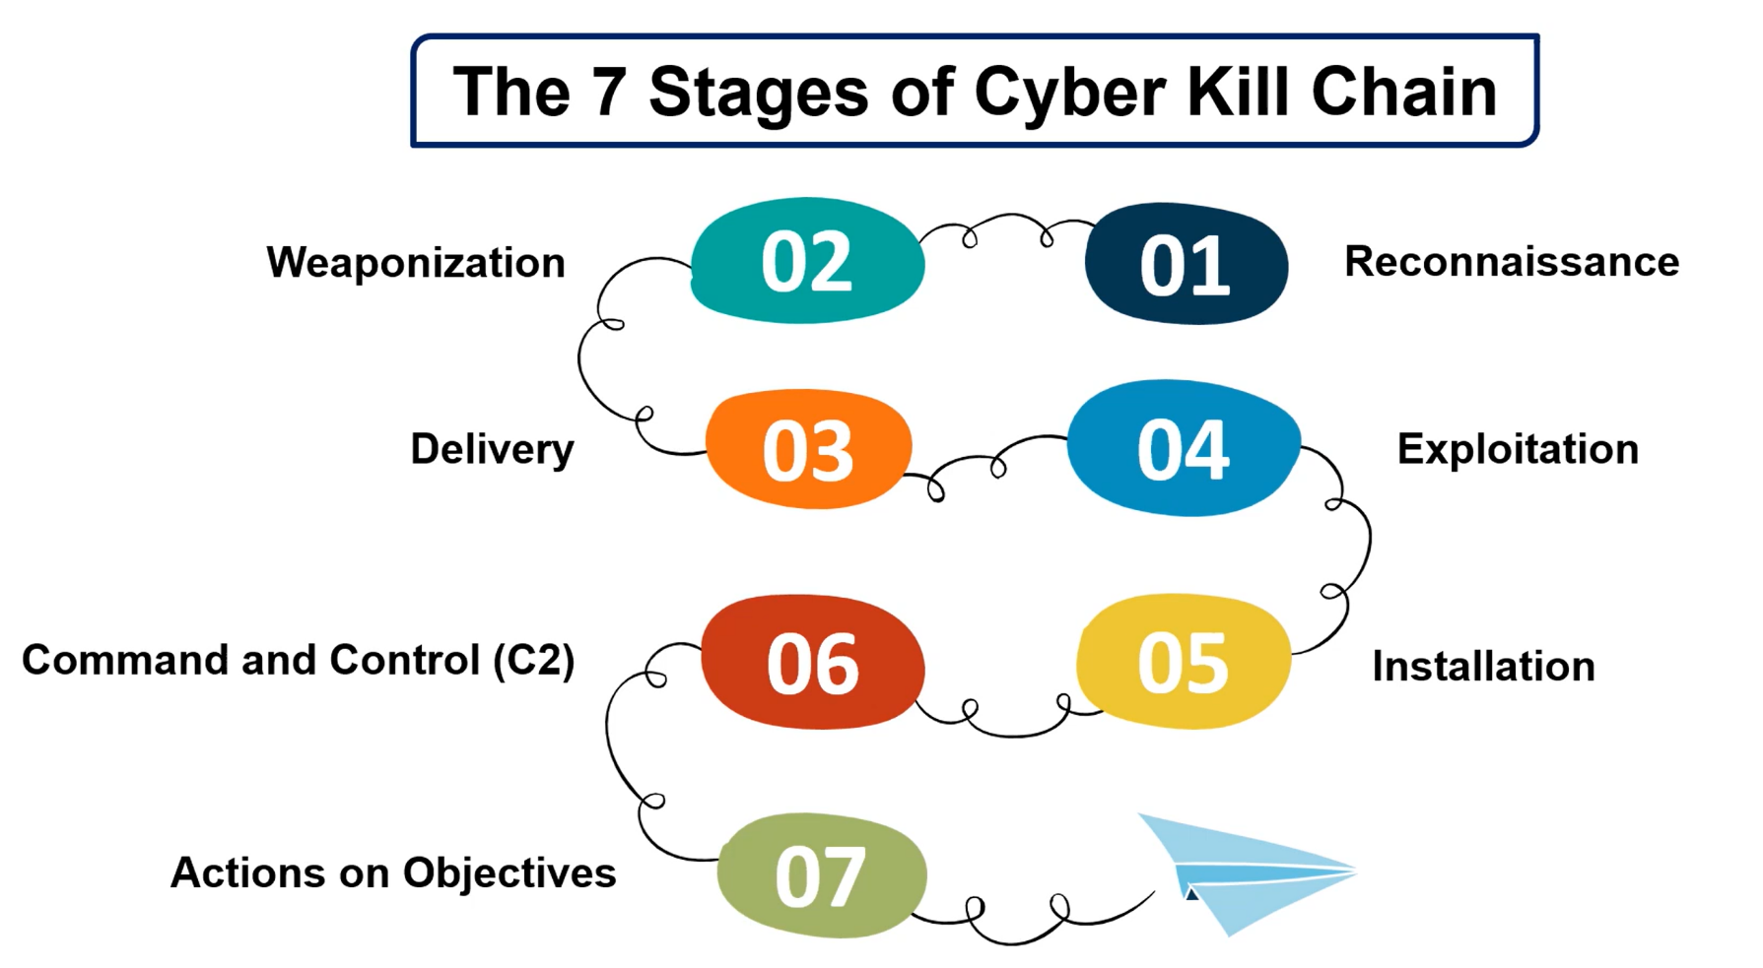
7-Stages of Cyber Kill Chain
Reconnaissance
↓
Weaponization
↓
Delivery
↓
Exploitation
↓
Installation
↓
Command & Control
↓
Actions on Objectives

Slide 6
7-Stages of Cyber Kill Chain
1. Reconnaissance: Information Gathering
The attacker collects information about the target.
Examples:
Finding employee emails
Scanning network ports
Collecting company information from social media
Tools used:
  Nmap
  Maltego
Example: An attacker finds the company email format like employee@company.com.

Slide 7
7-Stages of Cyber Kill Chain
2. Weaponization: The attacker creates a malicious payload.
Examples:
Malware
Exploit code
Malicious document
Example: A Word document containing a macro virus.

Slide 8
7-Stages of Cyber Kill Chain
3. Delivery: The attacker sends the malicious payload to the victim.
Common methods:
Phishing email
Malicious website
USB drive
Drive-by download
Example: A phishing email asking the employee to open an attachment.

Slide 9
7-Stages of Cyber Kill Chain
4. Exploitation: The vulnerability in the victim system is exploited.
Example:
Exploiting outdated software
Running malicious macros
Exploiting browser vulnerabilities
Example: Opening the document runs malicious code.

Slide 10
7-Stages of Cyber Kill Chain
5️. Installation: The attacker installs malware on the victim machine.
Examples:
Remote Access Trojan (RAT)
Backdoor
Spyware
Example: Installing a backdoor for remote control.

Slide 11
7-Stages of Cyber Kill Chain
6. Command and Control (C2): The compromised system connects to the attacker’s server.
The attacker can now:
Send commands
Control the infected machine
Download additional malware
Example: The malware connects to a hidden server controlled by the attacker.

Slide 12
7-Stages of Cyber Kill Chain
7️. Actions on Objectives
The attacker performs the final goal.
Possible goals:
Data theft
Ransomware deployment
System destruction
Espionage
Example: Stealing sensitive company data.

Slide 13
Importance of Cyber Kill Chain
Security teams use it to break the attack before it reaches the final stage.
Stopping the attack early reduces damage.
Stage | Defense Example
Reconnaissance | Firewall, IDS
Delivery | Email filtering
Exploitation | Patch management
Installation | Antivirus
Command & Control | Network monitoring

Slide 14
Cyber Kill Chain
Example Attack Using Kill Chain
Attack scenario:
Attacker researches company employees
Sends phishing email with malicious file
Employee opens file
Malware installs silently
Attacker gains remote access
Data is stolen
This entire process follows the Cyber Kill Chain model.

Slide 15
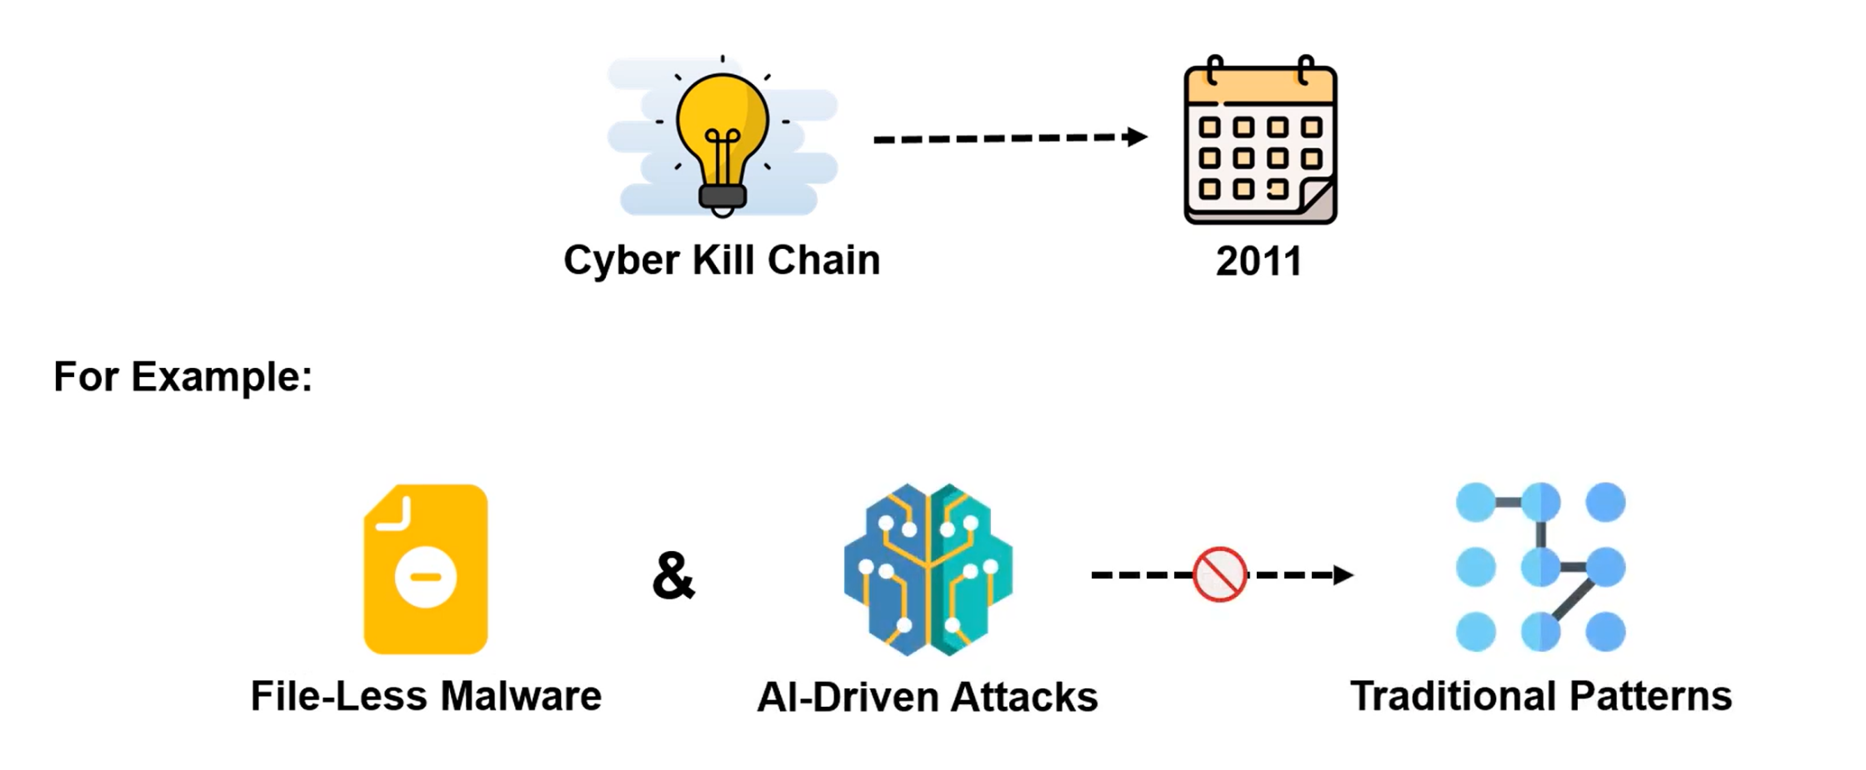
Evolution of the Cyber Kill Chain

Slide 16
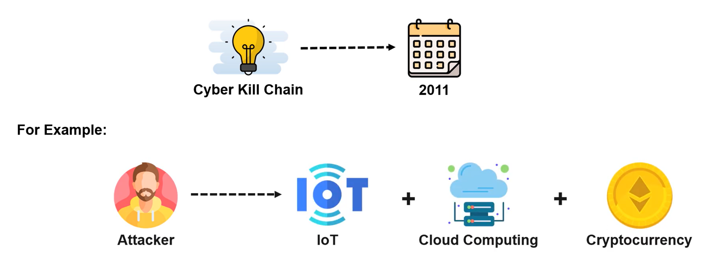
Evolution of the Cyber Kill Chain

Slide 17
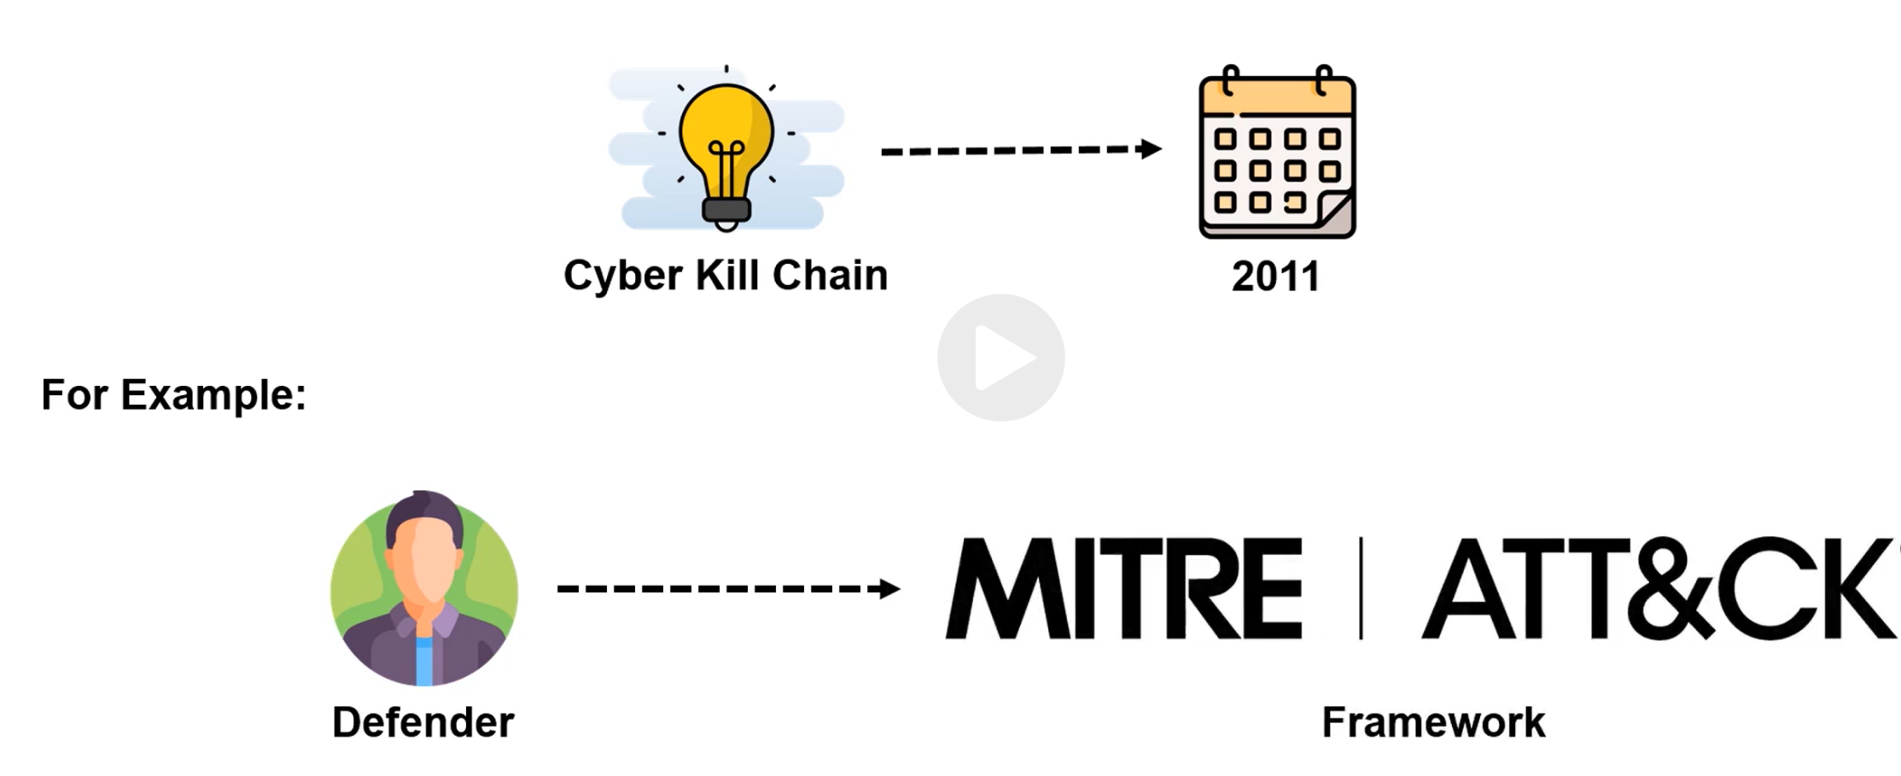
Evolution of the Cyber Kill Chain

Slide 18
Cyber Kill Chain Vs. Modern Models
Modern frameworks expand this concept, such as: MITRE ATT&CK
MITRE ATT&CK focuses more on attacker techniques instead of stages.
Cyber Kill Chain is a model that explains the step-by-step process attackers use to infiltrate and compromise a system.

Slide 19
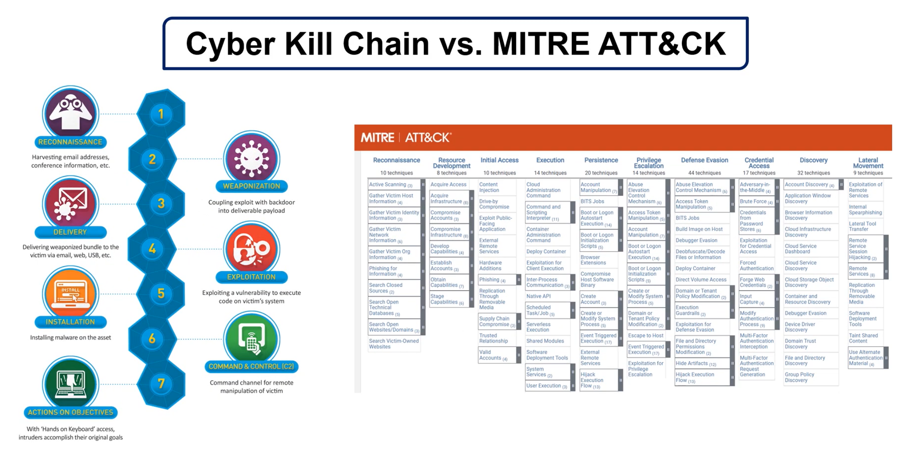
Cyber Kill Chain

Slide 20
Mapping to Ethical Hacking
Kill Chain Phase | Pen testing Phase
Reconnaissance | Information Gathering
Exploitation | Gaining Access
Installation | Maintaining Access
Actions | Reporting Impact

Slide 21
MITRE Attack
A knowledge base of real attacker techniques observed in real breaches.
Not a hacking guide — a reference framework.
Key ATTACK Layers (simplified)
Tactics → Why attacker does something
Techniques → How attacker does it
Procedures → Specific real-world examples

Slide 22
Common Tactics
Initial Access
Execution
Persistence
Privilege Escalation
Defense Evasion
Credential Access
Lateral Movement
Exfiltration

Slide 23
Kill Chain Vs MITRE ATTACK
We use Kill Chain to understand flow
We use MITRE to understand depth
Cyber Kill Chain | MITRE ATT&CK
Linear | Non-linear
High-level | Detailed
Strategic | Tactical
Easy to teach | Industry-grade

Slide 24
Blue Team Mapping
Attack Phase | Defense Action
Recon | Threat intelligence
Initial Access | Email filtering
Execution | Endpoint monitoring
Persistence | Log analysis
Exfiltration | Network monitoring

Slide 25
Thankyou

